Slide 1
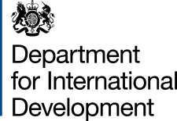

What do emerging trends in development finance mean for crisis actors? A UK perspective
DFID - Matthew Wyatt
May 2019

Slide 2
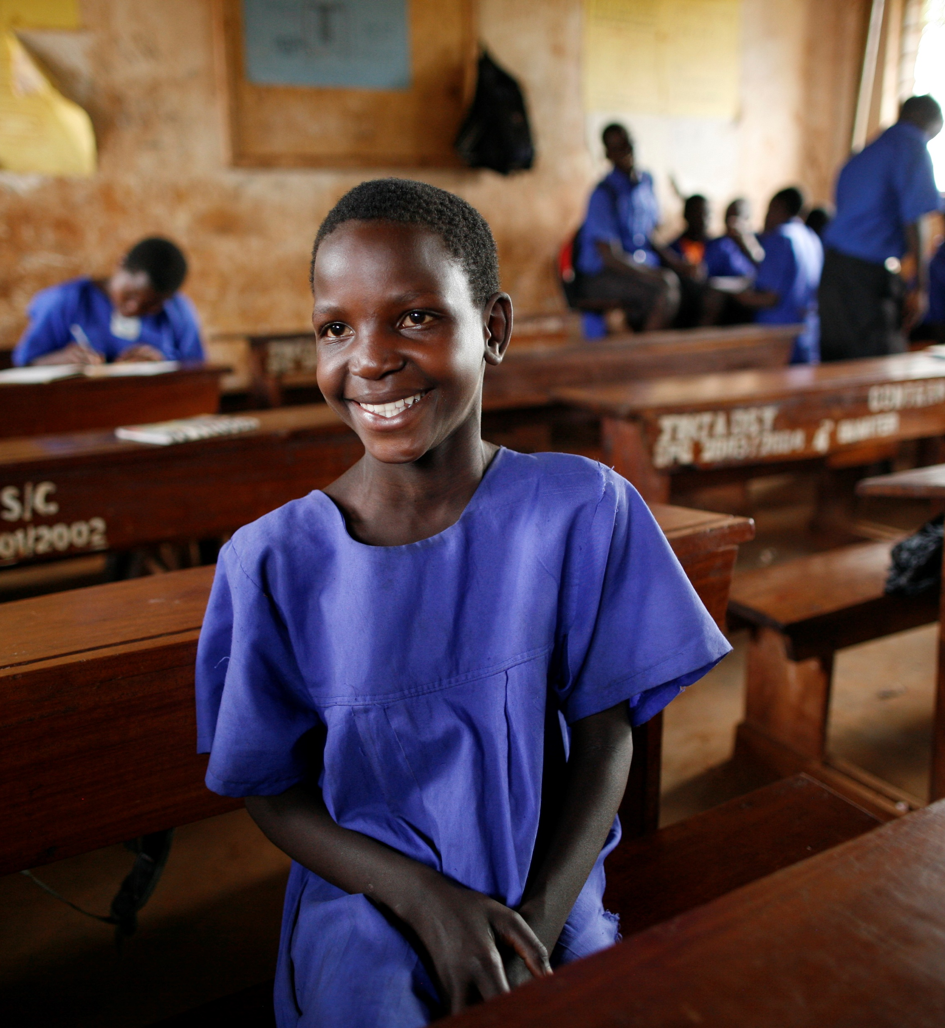

UK aid priorities
We aim to help people live a life of dignity and free from poverty through the SDGs and putting those furthest left behind first.
In 2015–18, the UK supported:
37.4 million children with immunisation,
11.4 million children with access to education,
40.3 million people with access to safe water and sanitation.
Source: DFID (2018), Department for International Development Annual report and accounts 2017-18

Slide 3
UK aid in FCAS and crises
Fragility, conflict, crises and climate change are growing threats to the SDGs.
The UK committed to spend 50% of UK aid in FCAS.
Through the UK Humanitarian Reform Policy and Building Stability Framework, the UK is helping build more peaceful, inclusive and resilient societies.
The UK is also responding to urgent needs and upholding humanitarian principles.

Slide 4
Financing for resilience and stability
Humanitarian, development and peace action must be coherent and complementary to address conflict and crises. They should work based on their comparative advantage, and with due consideration for the humanitarian principles.
This means taking a whole-of-portfolio approach to building resilience and supporting long-term peace.
In Burma, Nigeria and Somalia, we are helping build more effective and legitimate institutions, resilient health and education services. We work to make economic development more inclusive, and support mediation between conflict actors as well as peacebuilding.

Slide 5
Financing for resilience and stability (2)
We are also strengthening resilience and preparedness and addressing the underlying causes of conflict and fragility through individual programmes.
We are building the resilience of health systems to detect and respond to nutrition emergencies in the DRC, Somalia, and Ethiopia.
In Burma we work to increase the capacity of all stakeholders to engage in social cohesion projects to strengthen trust and lay the foundations for sustainable peace.
We are helping put in place new financing instruments for resilience.
We set up the Global Risk Financing Facility with Germany to help strengthen government disaster management capacity.

Slide 6
Effective financing in crises means
Bridging the financing gap for prevention and resilience, particularly in conflict and protracted crises;
Innovative mechanisms that incentivise investments in prevention, resilience and risk reduction, including through risk financing;
Ability to work adaptively, flexibly and support preparedness, through multi-year programmes;
Using development channels when better suited to address needs;
Humanitarian responses designed to lend themselves to transition to longer-term programming approaches.

Slide 7
Effective crisis approaches also require…
Focus on supporting those most left behind first;
At a minimum ensuring conflict-sensitivity grounded in good contextual and political understanding;
Capacity to work politically and be conflict and protection-sensitive;
Ability to see beyond our programmes’ primary objective, so they make a positive contribution to peace and resilience, where possible and appropriate;
Consider how aid impacts over time conflicts and conflict economies, and use this evidence to inform strategies;
Building and applying the evidence of what works.

Slide 8
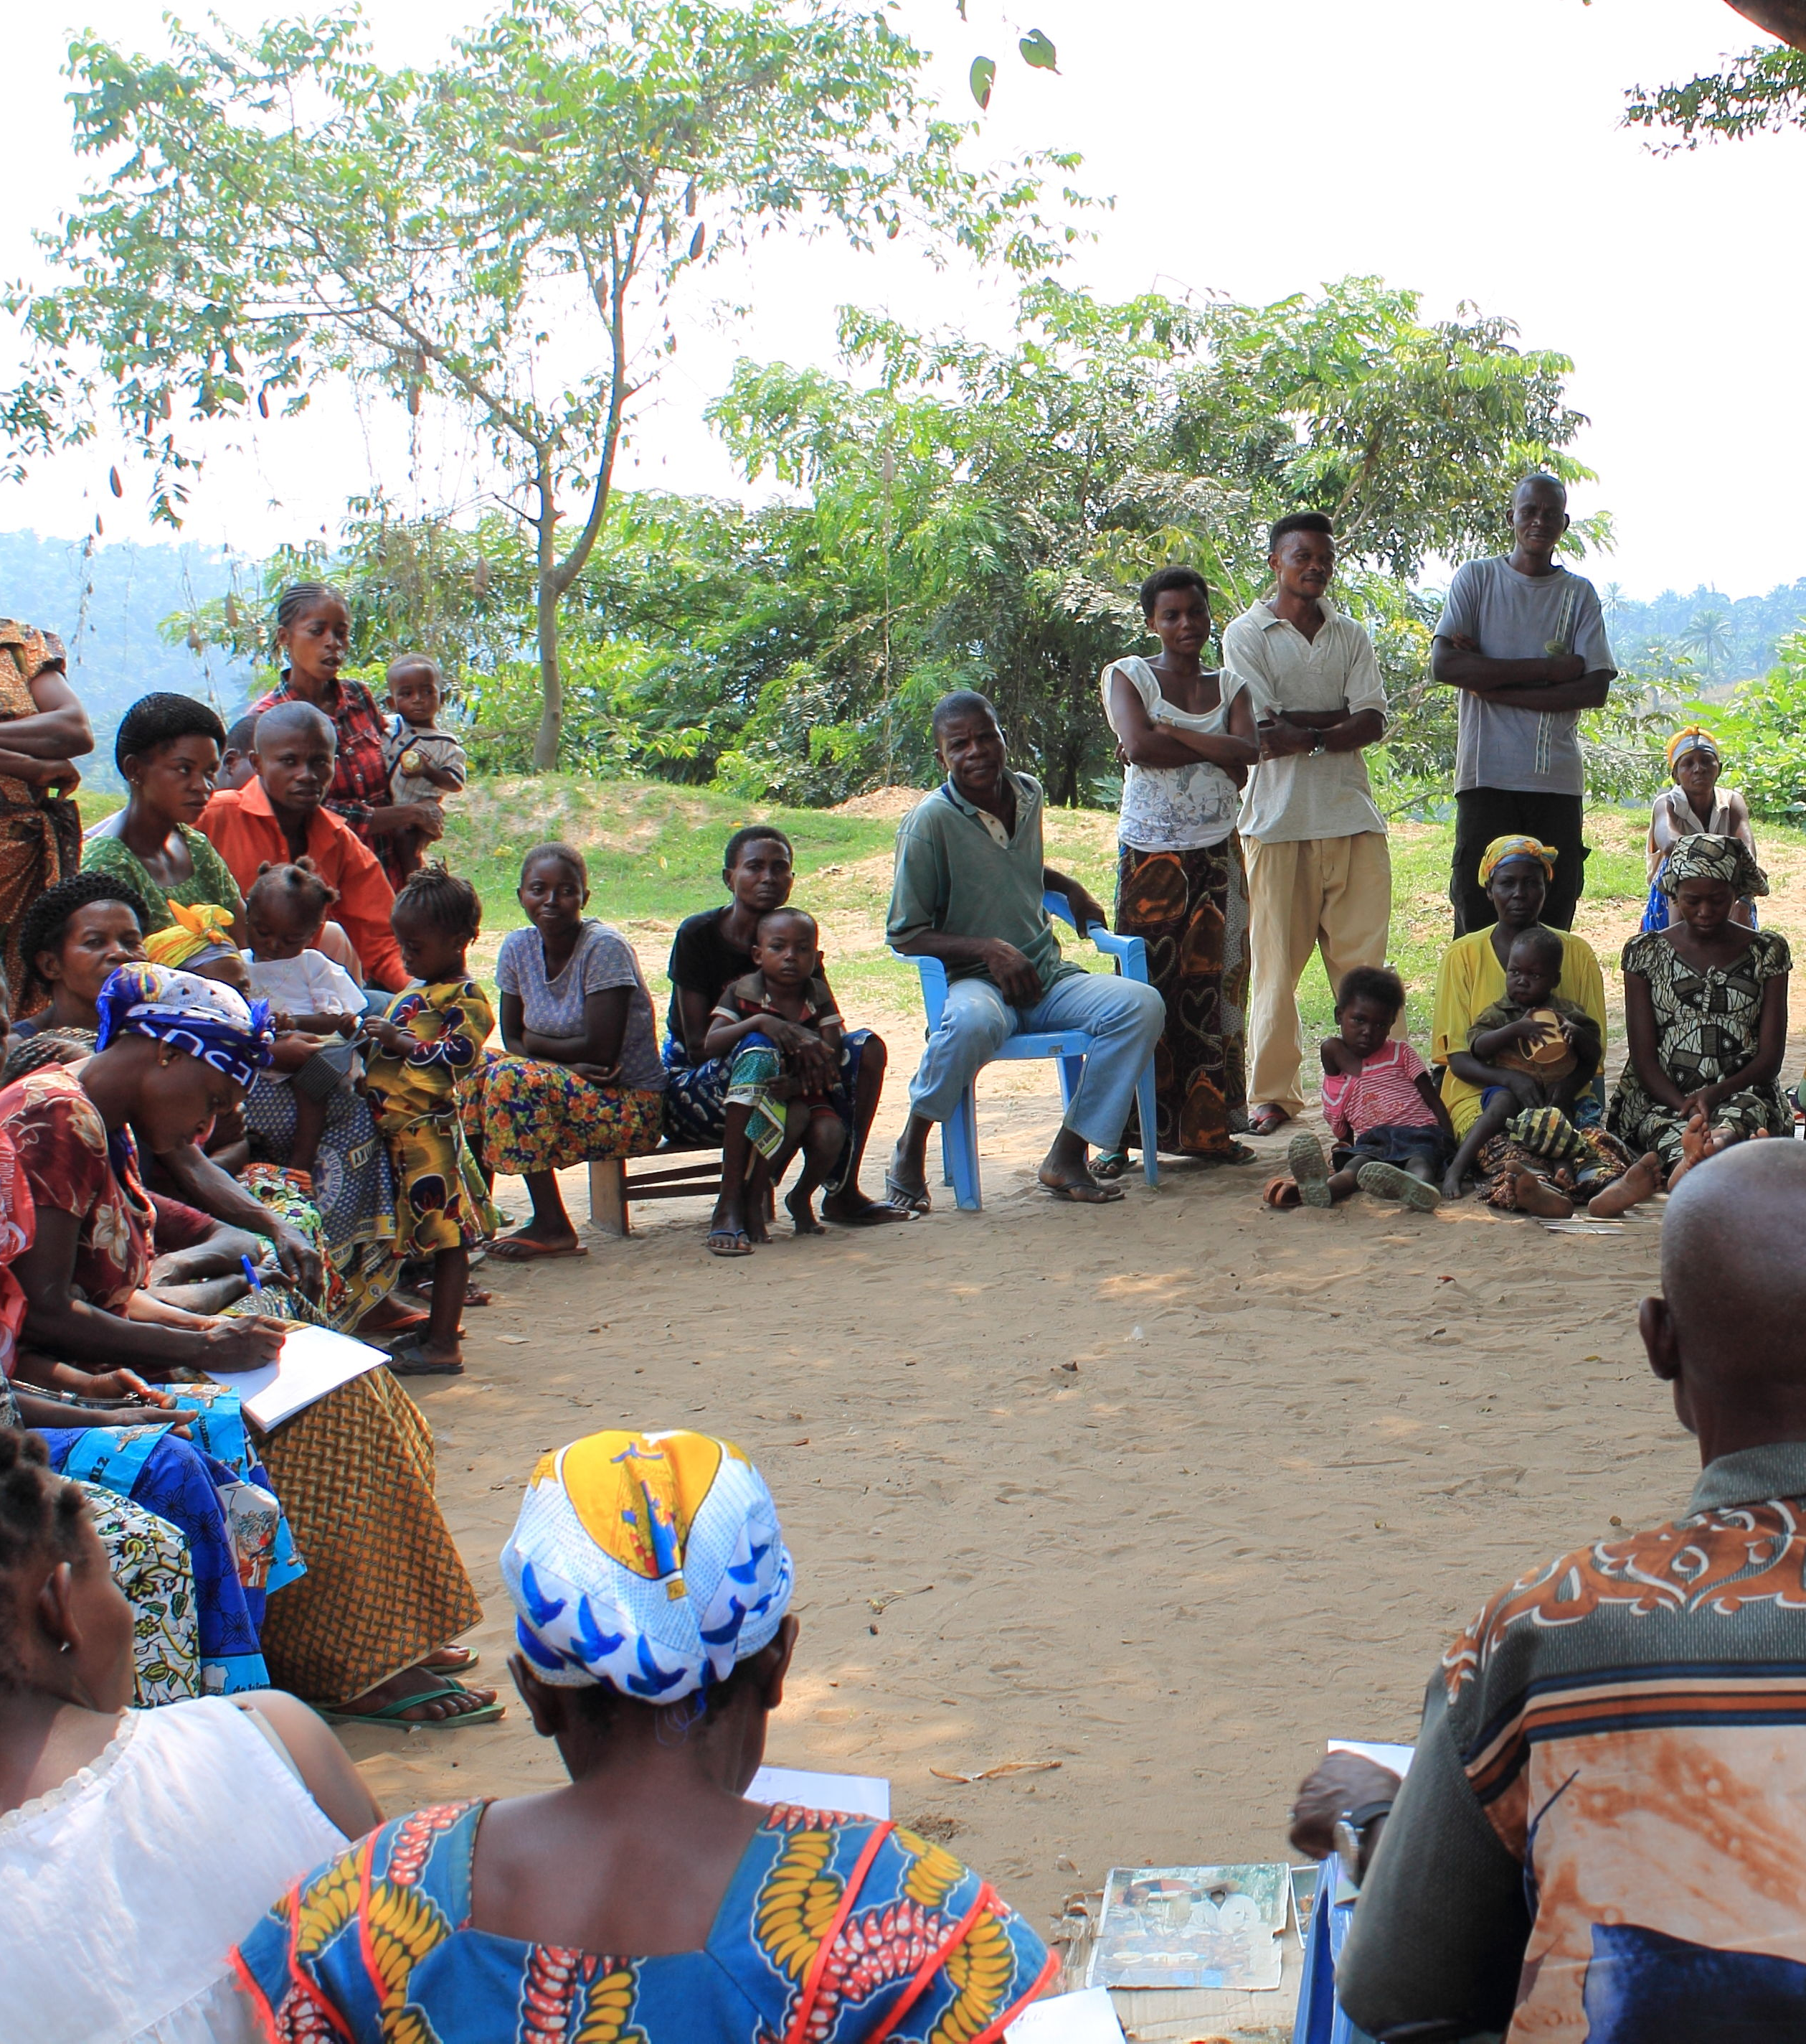

Challenges and way forward
We need:
To change the incentives skewed towards ex-post responses.
Better risk management approaches.
Avenues for progress:
Better coordination through empowered RC/HC;
New IFI financing mechanisms;
Supporting NWoW, GCR, GB, EU nexus pilots and other initiatives;
A new platform for collaboration, potentially the OECD and DAC nexus Recommendation.

